Slide 1

.
Comprehensive Abortion Care Service In Oromia Region
October 22,2013

Slide 2
Outline of Presentation
Introduction
Functionality of the health system
Leading direct Causes of MM (80%), Ethiopian context
GO and NGO Partnership
Collaboration Areas with partners
Trends of CAC & PAFP service
Challenges
Lessons

Slide 3
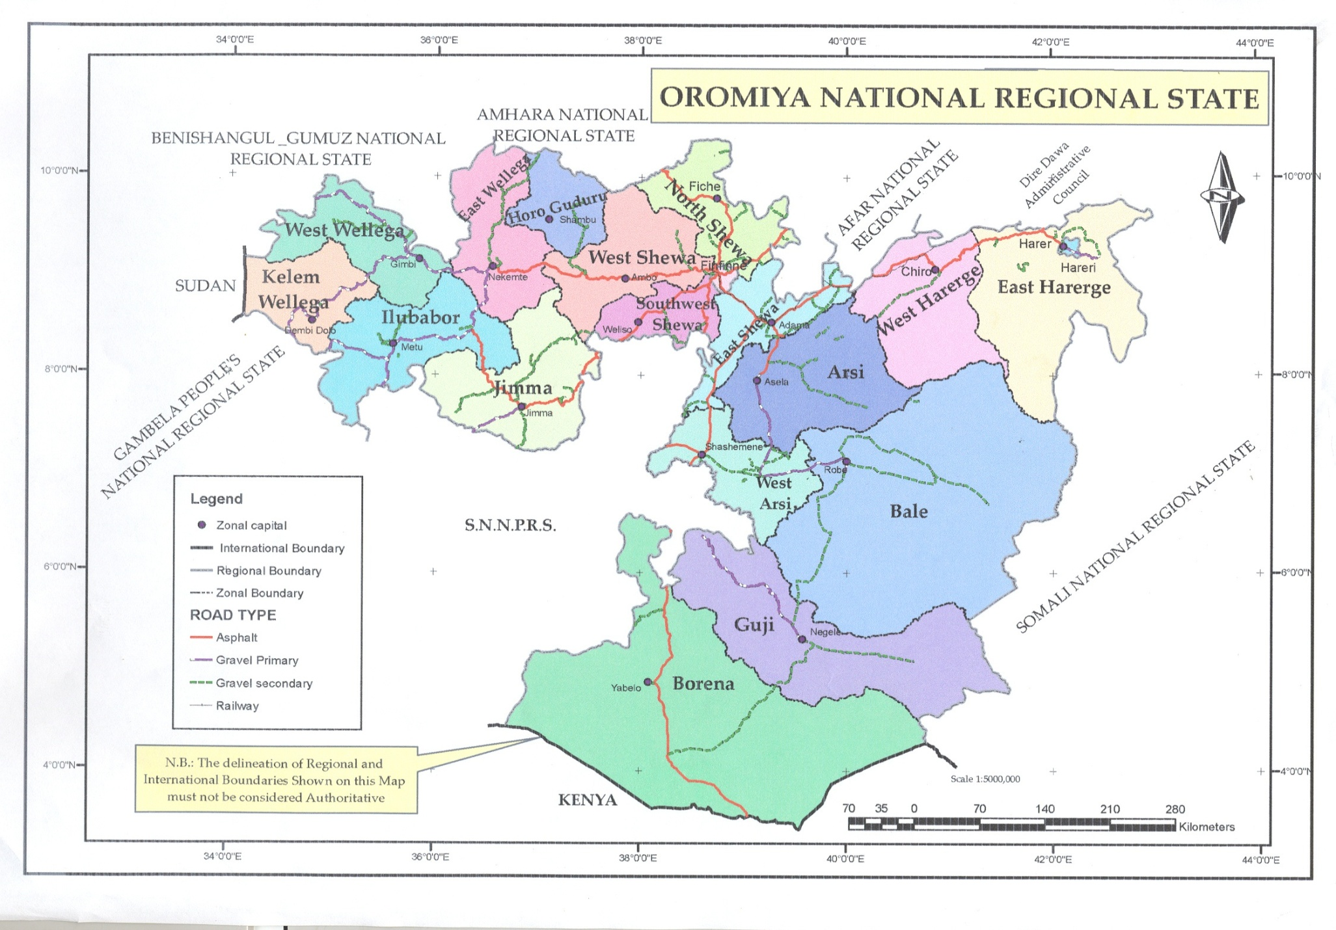

Slide 4
Back ground information of Oromia Region
        Population = 32,976,276 (89% are farmers)
Zones = 18 Admin/Towns = 12
Woreda = 306
Kebele = 7021
Health facilities
Public:
  Hospitals------------- 42
  Health centers--- ---1215
  Health post-----------6,165

Slide 5
Back ground information…
NGO and OGO.
  Hospitals--------- 8 (4 OGO, 4 NGO)
  Health centers----- 5
  Cilinics ..................195
  Health posts.............. 5
3. Private health Sectors
    Hospital.........................4
    Different clinics.............1,639
    Drug stores, pharmacy---- 966
    The potential health service coverage is more than 90%

Slide 6
Functionally of the health system
The health post provides preventive and promotion health services with basic prevention based treatment
The health center provides comprehensive primary health care services and provides technical backup and receiving referral from the health post
The primary hospital provides basic curative services mainly focusing on emergency obstetric care service,
The general and referral hospitals provide secondary and tertiary health care services respectively

Slide 7
Leading direct Causes of MM (80%), Ethiopian context
Unsafe abortion decreased from (32% - 13%) currently
Obstetric hemorrhage
Hypertensive disease of pregnancy
Obstructed labor
Sepsis

Slide 8

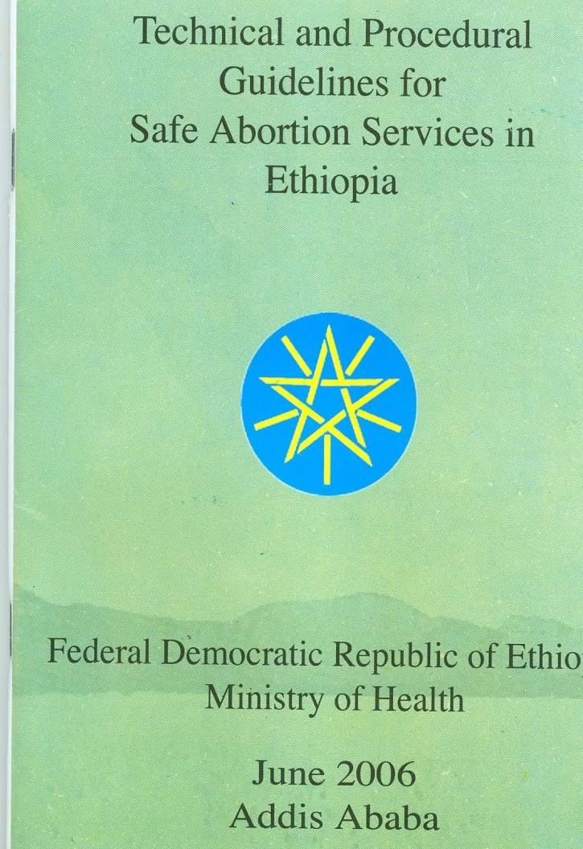
The Law and Abortion
The Revision of The Penal Code May 9, 2005
The Guideline, June 2006
Notes:
Rationale for revision
Higher national maternal mortality ratio – one of the highest in the World
Unsafe abortion: number one cause of maternal mortality in Ethiopia (32%)
Nearly half million abortions of all kind occur every year
Legal prohibition cannot prevent abortion but it makes the procedure unsafe and dangerous
The Guidelines
Interpret the law
Define women’s eligibility
Determine where services are provided
Determine who provides abortion care
Outline providers responsibilities
Provide guidance to the care of women

Slide 9
GO and NGO Partnership
Oromia Health Bureau works in partnership with different partners on comprehensive abortion care and contraception:
  Ipas Ethiopia
  IFHP
  EngenderHealth Ethiopia,
  MSI Ethiopa,
  Dkt Ethiopia
  FGAE and others
Partners forum and mapped to avoid duplication

Slide 10
Collaboration Areas with partners
Training of service providers, health managers and pharmacy personnel
Information and education dissemination about the revised law, prevention strategies of unsafe abortion
Support with supplies and equipment
Facility renovation/civil work to ensure quality of service
Joint monitoring, supervision and evaluation

Slide 11
Outcomes
The health seeking behavior of the communities are improving
The number of safe abortion care clients are increasing
The number of family planning clients are dramatically increasing over time:
  Particularly the long acting family planning

Slide 12
Trends of CAC & PAFP service
Year CAC PAFP
2008 7765 5609(72%)
2009 9069 6334(70%)
2010 16882 14163(83.8%)
2011 23591 19295(81.8%)
2012 35987 33531(93%)

Slide 13
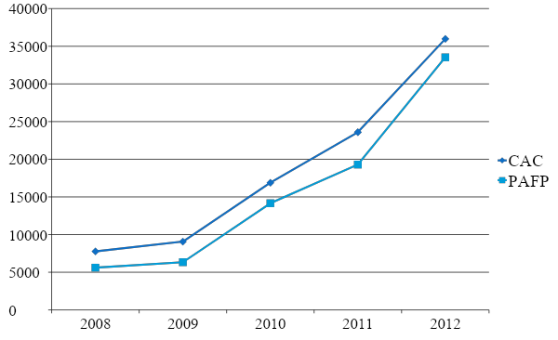
Trends of CAC & PAFP service

Slide 14
Challenges
Limited capacity to expand services in all facilities
Turnover of trained staff
Still the infrastructure to reach the grass roots level need more work

Slide 15
Lessons
Integration of family planning with abortion care services
High commitment of service providers (mid-level) has increased service uptake in a short period of time
Promising partnership and collaboration with partners(Ipas, MSIE, EngenderHealth, Dkt, FGAE and others)

Slide 16
.
.
THANK YOU

