Slide 1
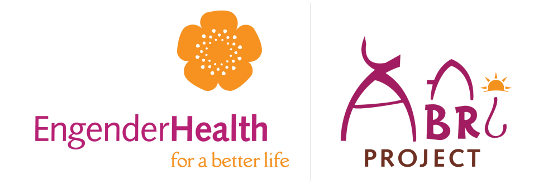

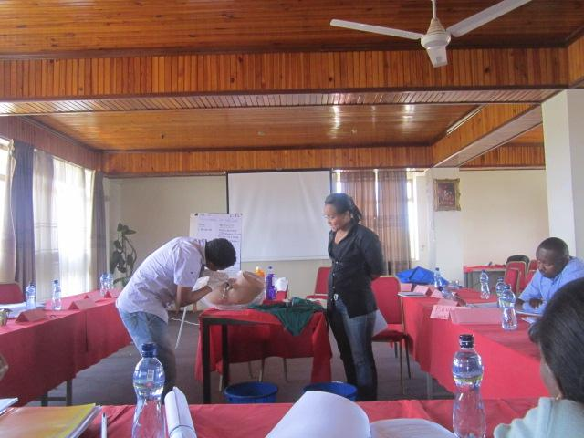
Engender Health Ethiopia
CAC Program experience
Oct.22, 2013

Slide 2
Outline of presentation
Background of EH
Key interventions
Major achievements
Challenges
Success factors and lessons learned

Slide 3
Background EH
EngenderHealth, formerly called AVSC, is an international NGO established in 1943, with 70 years experience in SRH worldwide.
Works to improve the health and well being of people in the poorest communities of the world with focus on “Helping Women Achieve their Reproductive intention”
Committed to ensuring that every pregnancy is planned, every child is wanted, and every mother has the best chance of survival.
Currently, support more than 20 countries focusing on maternal health, HIV and family planning.

Slide 4
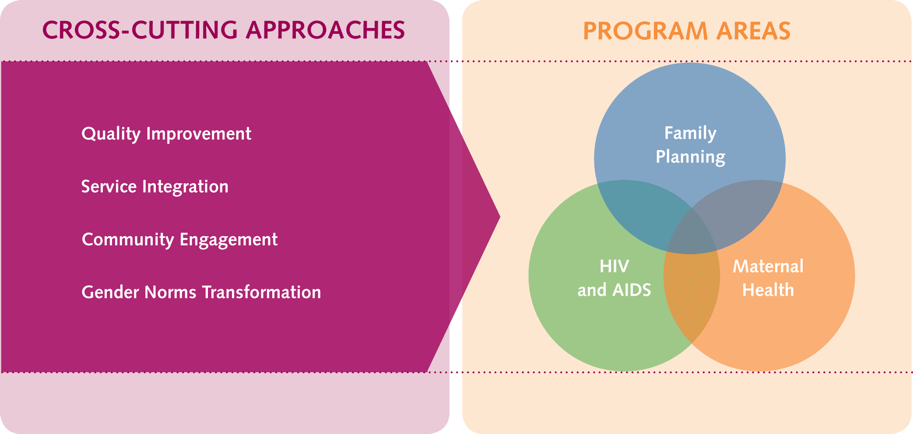
EngenderHealth’s Program Focus
Notes:
EngenderHealth recently completed a new Strategic Plan, wherein we reaffirmed our commitment to working in three program areas: Family Planning, HIV, and Maternal Health. In particular, we are emphasizing four cross-cutting approaches to our work -- Quality Improvement, integration of services, engaging communities, and promotion of positive gender norms to advance choice and rights within these three programmatic areas.

Slide 5
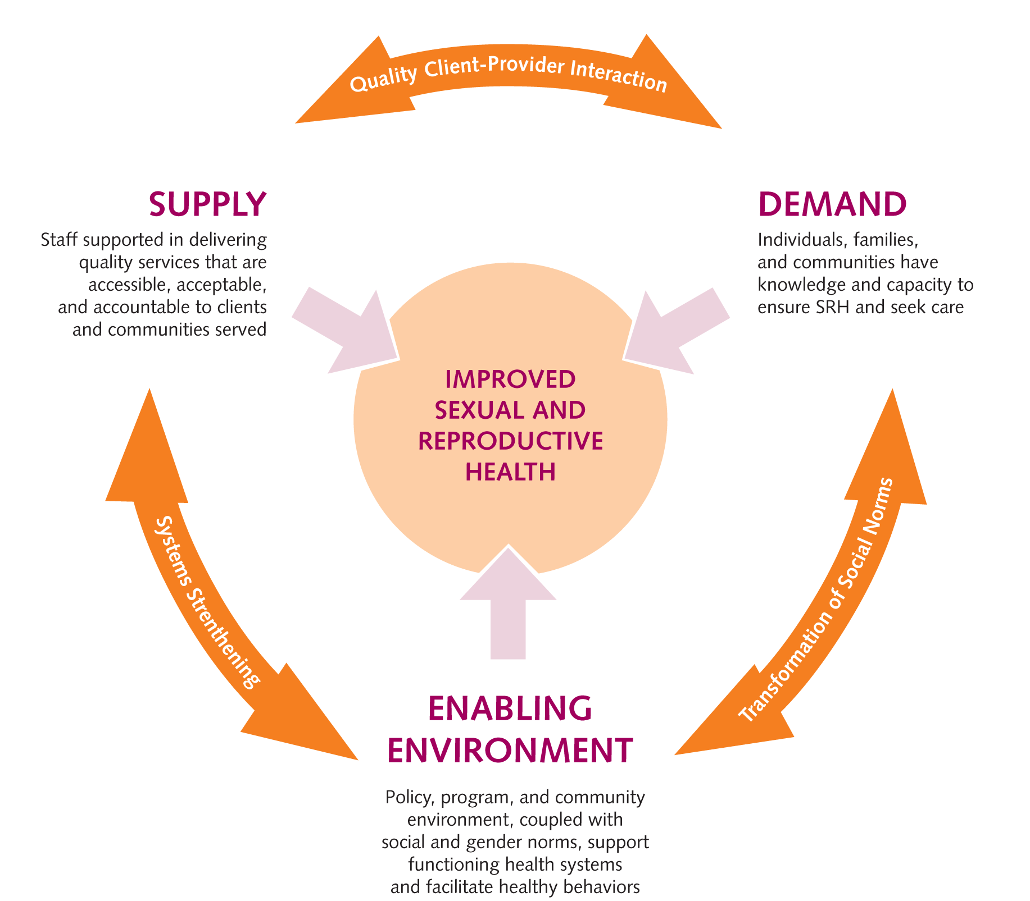
EngenderHealth's SEED Programming Model
Notes:
FP: Meeting Clients’ Reproductive Intentions
HIV:
Maternal Health:
1. SEED cornerstones for success and sustainable SRH programs – Interventions which:
address quality services and other supply-related components
strengthen health systems and foster an enabling environment for SRH-seeking behavior
improve knowledge of SRH and cultivate demand for services
2. Explicitly recognizes and responds to the complexity of tasks needed to improve health outcomes
A comprehensive approach to program design
Employ biomedical, behavioral, and structural approaches to meet SRH goals
Highlights range of interventions needed at various levels
A framework for partnering: Multiple stakeholders can best address all 3 components and ensure national reach
SUPPLY
1. Quality services are the cornerstone of any health program
2. Elements which contribute to ensuring quality services:
Supported staff (equipped working environment, supportive supervision)
Services that are accessible, acceptable, and accountable to the clients and communities served^{[1]}
Administrative, financial, and management systems in place
Evidence-based medicine and the use of data for decision-making
Strong linkages between health services and the communities they serve
ENABLING ENVIRONMENT
1. A country’s larger social-cultural, economic, and political environment influences the functionality and sustainability of the health system (Supply), as well as social norms surrounding healthy behavior (Demand).
2. Investments in Supply and Demand interventions may not be effective or sustainable if the Enabling Environment is not addressed during program design and implementation.
3. Leadership is the key to establishing an enabling environment
Need to foster champions at all levels of the health system and within the community to address SRH issues
Leaders can advocate for policies, resources, that ensure program capacity for quality SRH services
Leaders can challenge social and gender norms
4. Need to engage communities to move SRH discourse from the private to the public realm
Encourage discussion and bring about communal commitment to ensuring SRH well-being
Change (mis)perceptions, behavior, and social norms and gender inequality
DEMAND
1. Available services are often the least of the many barriers to people realizing their sexual and reproductive well-being
2. Programs outcomes must result in individuals, families, and communities having the knowledge, capacity, and motivation to ensure SRH and seek care
3. Demand activities:
Range from education to social marketing
Provide evidence-based, comprehensible information
4. Goals:
Increase knowledge and self-efficacy
Encourage communication among couples, peers, and within families
Promote care-seeking and use of services
SYNERGIES BETWEEN COMPONENTS
Interventions based on the 3 components of SEED do not operate in isolation. They impact each other (represented by the bridging arrows in visual model)
Quality Client-Provider Interaction (S & D)
Is realized when a knowledgeable, empowered client interacts with a skilled, motivated service provider at an equipped and well-managed service site.
Example: Supply-side investment in counseling training for staff enables the provider to have a positive influence on client’s level of knowledge and demand for services.
Systems Strengthening (S & EE)
Includes interventions to address service delivery, health workforce, information, equipment & supplies, financing, and management/governance.
Many supply-side interventions require systems strengthening to be sustainable.
Need to systematically engage communities to ensure their input, and have services be accountable to the communities they serve.
Transformation of Social Norms (D & EE)
Social norm: a value, belief, attitude, or pattern of behavior to which most people in a particular community or culture adhere, and are expected to conform to.
Undertaking demand-side interventions concurrently with strengthening an EE increases individual knowledge and awareness of SRH, as well as capacity to ensure SRH and seek care.
UNDERLYING PRINCIPALS
EngenderHealth subscribes to four underlying programming principles of good program design and implementation, which are the foundation of EngenderHealth’s approach to its work.
Fundamentals of Care
The essential elements of ensuring quality SRH services, particularly (though not exclusively) in a clinical setting
Include informed choice, medical safety, quality improvement
Evidence-Based Programming
The explicit use of data and scientific evidence during the design and implementation of a program
Can include formative research, data for decision-making, monitoring and evaluation of a program, operations research, use of literature reviews and international guidelines
Allows more efficient use of resources
Higher likelihood of success by avoiding “reinventing the wheel” and taking advantage of previous experiences and existing knowledge on “what works”
Useful in advocacy efforts
Programs should be designed from onset to contribute to evidence base
Gender Equity
An equity approach recognizes that men and women face different constraints, and have a different level of resources to deal with their health problems
Men and women may need to be dealt with differently to achieve improved SRH for both
Gender work should challenge and transform social norms and gender inequities
Stakeholder Engagement
A process of involving those who have an interest in and/or are affected by a program’s activities and goals
Can include capacity-building, dialogue and consultation, collaboration in problem/solution identification, partnership in implementation/evaluation
May have different stakeholders at different levels of program implementation
Ensures that both decision-makers and the intended beneficiaries are involved in the program design
Increased likelihood that the community’s needs and preferences are addressed, and appropriate interventions are chosen
Contributes to sustainability and ownership by involving those best to continue work
Why is it important? What distinguishes this model?
Very few FP programming models exist
Existing models lack the enabling environment component of holistic FP programming
WHO’s Strategic Approach to strengthening SRH policies and programs (2007) largely focused on Supply; little on Demand; EE mostly on laws/regulations/policies, and is weak on community and stakeholder engagement
SEED
Equal representation of Supply, Enabling Environment, and Demand factors ^{[1]}
Explicitly recognizes transforming social norms (including unequal gender norms) as an objective. This is unusual in program models.
Recognition of the integral role of communities in the design, delivery, and sustainability of quality programs by incorporating in all 3 components
Can promote integration of FP, HIV and MH
Ensures a comprehensive approach to design and implementation of SRH programs, thus improving the likelihood of success and sustainability

Slide 6
EH in Ethiopia
Small but vital presence since 1987
Opened office in 2001 with 5 year program to expand LAPM FP methods use
  It works to support the effort of the government in meeting its health strategic objective and the MDG:
  Reached more than 5 million clients with information
  Served more than 3.4 Million women and men including
    Nearly half million LAPM clients ( nearly 100,000 IUCD)
    70,000 women with life saving CAC

Slide 7
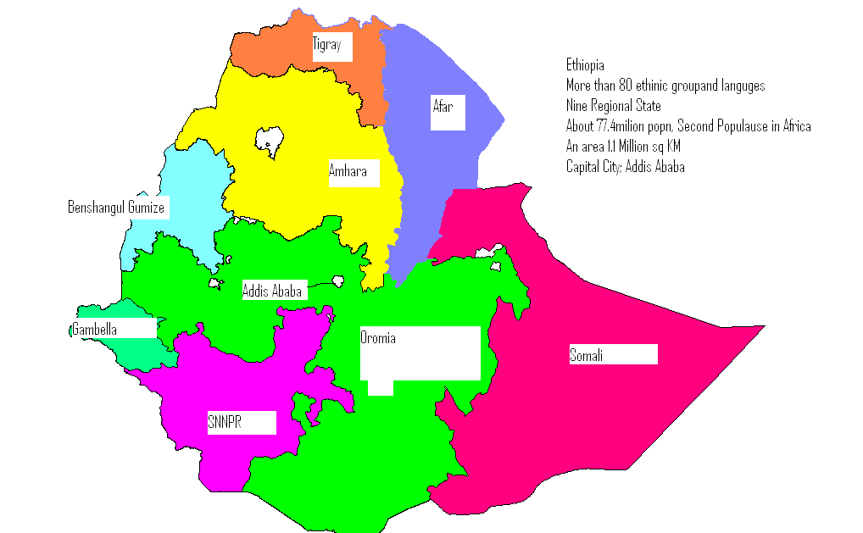
Background to EH Ethiopia-Impact Areas
  Current Portfolio
  ABRI project: FP, CAC and other RH activities
  Mobile-outreach project: FP/LAPM
  TA for ORHB: Demand Creation for Institutional Delivery especially EmONC
  TA for MULU MARPs project: MAP
In Ethiopia EH
Work in 205 Woredas across 5 region and two City Administrations
20 million population
Directly support 424 Health Facilities

Slide 8
Key Interventions on CAC
In-service training and rigorous post training follow up on CAC
Renovation, and provision of Equipment, Instruments and supplies
Integration of CAC with FP
  Training of provider in both CAC and FP
  Ensuring method availability at CAC unit or by referral to FP unit
Clinical Monitoring and Coaching
Systems Support ( QI/COPE,IP, FS, etc…)
Support for Enabling Environment including policy issues
Joint planning and performance review
Notes:
Trained 571 providers in CAC (2.2 per facility)
Equipped all 257 sites with MVA kits, MA drugs and other needed supplies

Slide 9
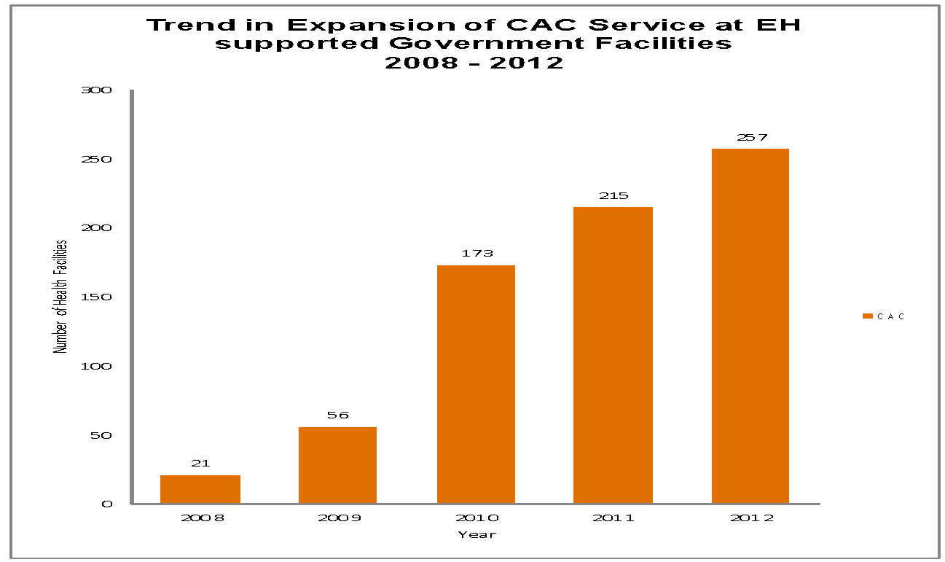
Major Achievement
Notes:
Expanded access to CAC services from 21 in April 2008 to 257 health facilities in December 2012

Slide 10
Trends in CAC Services Utilization
Notes:
Served nearly 70,000 client with life saving abortion care services

Slide 11
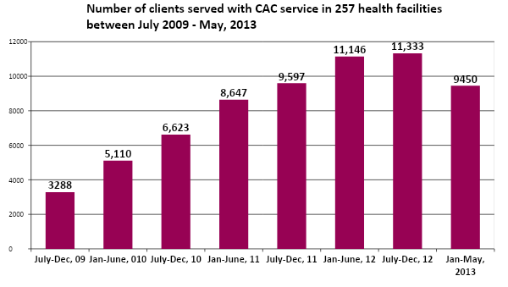
Trends in CAC Services Utilization
Notes:
Note data for Jan-May is for 5 month.

Slide 12
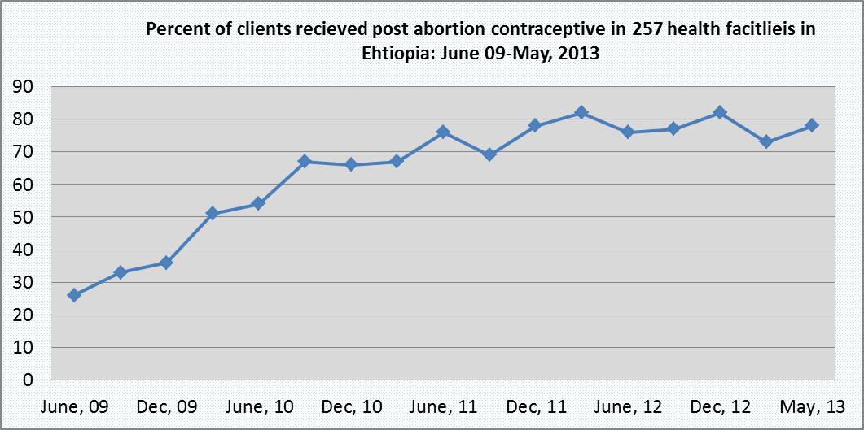
Trend in PAFP Uptake

Slide 14
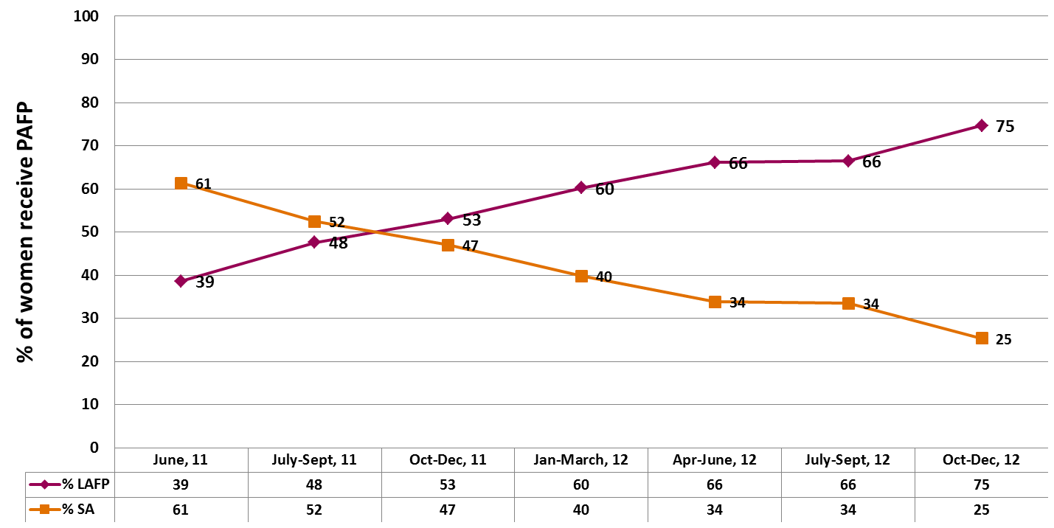
Trend in PAFP Method Mix, June 11 – Dec 12
Notes:
This graph shows the declining trend in SA methods while there is a progressive upward trend in the uptake of highly effective Long Acting FP methods by post-abortion clients. Over 60% of PA/FP clients use SA methods when CAC services were initiated and currently less than 30% of clients use SA methods.

Slide 15
Challenges
Attrition of trained providers
Providers attitude/value related problems
Burnout of trained providers
Persistence to use D&C and E&C by some providers

Slide 16
Success Factors and Lessons Learned
Use of Comprehensive Strategy (SEED Model)
Competency based training especially counseling & clinical skill as well rigorous training follow up, Clinical Monitoring and Coaching
Integration of services
    FP- CAC integration
    Training on FP for CAC providers
Intensive progress review and planning mechanisms

Slide 17
Success Factors and Lessons Learned……
    Recognizing high performing HF’s
    Involving Site-level staff and managers
      Monitoring and Reviewing CAC and PAFP data
      Identifying bottlenecks to CAC service
      Identifying appropriate solutions that can be implemented by themselves
    Improving ownership owing to continued sensitization and engagement of WoHO’s, ZHD’s and RHB’s

Slide 18
Thank You!

