Slide 1

INITIAL CONSULTATIONS
ON THE CONSTRAINT ANALYSIS DRAFT REPORT
JULY 2013

Slide 2
Agenda
Introduction: The Millennium Challenge Corporation
Introduction: Millennium Challenge Coordinating Unit 101
MCC’s Approach to Identifying Projects - Constraints Analysis, Social and Gender Assessment and Investment Opportunity Analysis
Preliminary Findings of Constrains Analysis – Likely Binding Constraints
[Preliminary Findings of Social and Gender Assessment]
Discussion Sessions

Slide 3
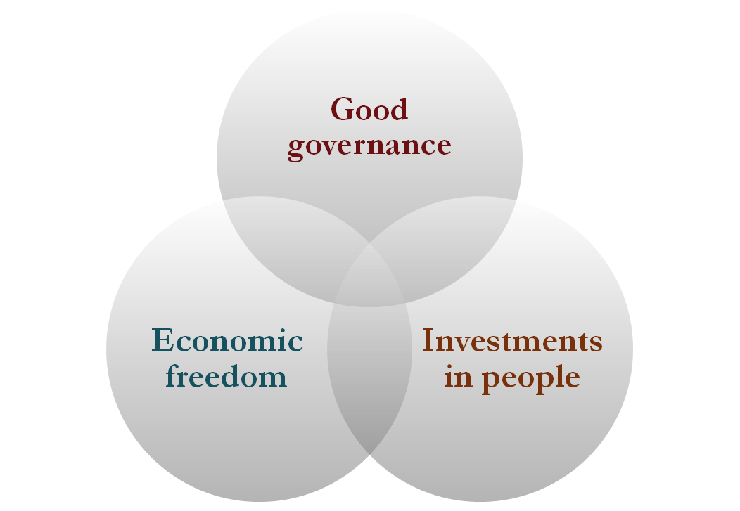

Introduction: MCC
WHAT IS MCC?
The Millennium Challenge Corporation (MCC) is a U.S. Government agency designed to reduce poverty through economic growth in select developing countries.

Slide 4
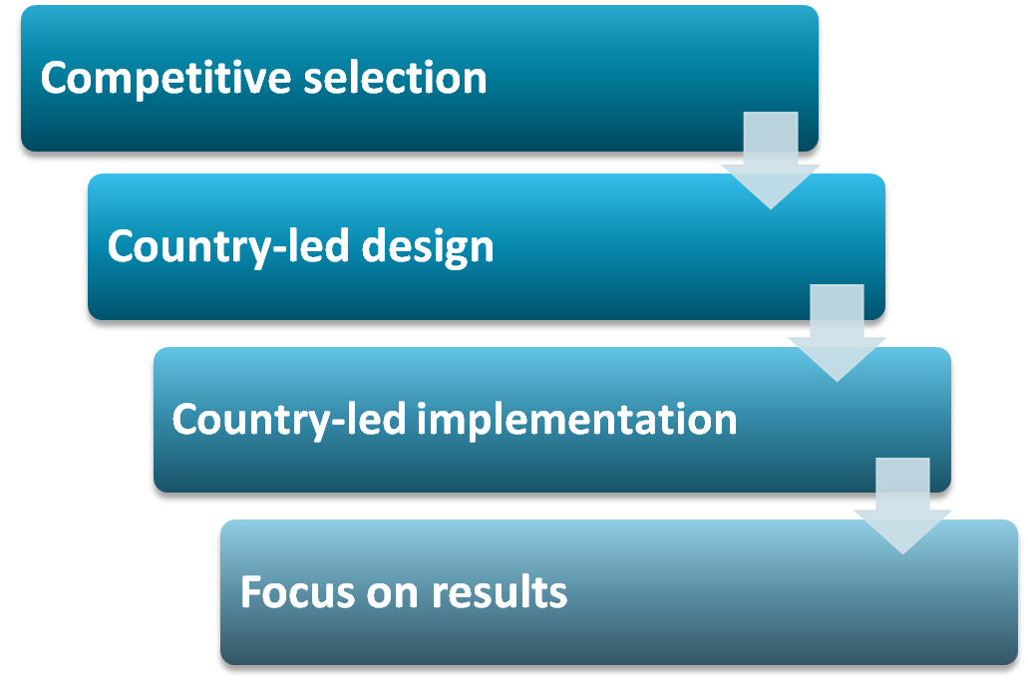
WHAT’S DIFFERENT ABOUT MCC?

Slide 5
What is a Compact?
MCC Compacts are….
5-year agreement grants between MCC and a partner country to support agreed development objectives through an integrated set of projects and activities and must be implemented within 5 years Awarded to eligible countries as determined by MCC’s eligibility criteria and final vote of the MCC Board of Directors Typically large-scale and complex projects/activities Over $7 billion awarded as compact grants to 25 partner countries worldwide Implemented by the partner country government with guidance and oversight from MCC Examples of MCC funded activities include Agriculture, Water & Sanitation Infrastructure, Healthcare Infrastructure, Education, Microfinance, Policy Reforms etc

Slide 6
MCCU
MCCU is the body established by Government with the responsibility to drive the Compact Development Process up to the signing of the compact
MCCU is therefore responsible for developing the Constraints Analysis, Social & Gender Analysis, and the Investment Opportunity Analyses
MCCU is also responsible for monitoring the performance of Government with respect to the MCC indicators

Slide 7
MCC’s Approach to Identifying Projects
Compact developments starts with an analysis phase
Partner countries conduct rigorous analyses to identify binding constraints to private investment and economic growth
3 pillars of analysis phase:
  Constraints analysis
  Social and gender analysis
  Investment opportunity assessment

Slide 8

Constraints Analysis
What is a Constraints Analysis?
What does it do?
Based on 2005 study by economists from Harvard, World Bank
Analytical framework that examines impediments to economic growth
Seeks to identify factors that impede private investment and growth
  Low private returns
  High costs of capital
Uses a “decision tree” to guide analysis
Data-driven analysis of entire domestic economy
Prioritizes concerns that most impede economic growth
  “Binding constraints” to growth
  High demand, but low supply
Does not provide answers or solutions
Provides useful framework for public consultations
Requires further analysis to reach specific project ideas

Slide 9
Social and Gender Analysis
Identifies issues that impact intended beneficiaries (different social groups including the poor, women, disabled) in a specific sector, region or context
Assesses legal, policy, institutional and socio-cultural aspects of binding constraints, and related issues that can disadvantage certain groups in the country
Goal: To ensure projects deliver maximum benefits to targeted populations – and ensure that access to opportunities are equitable (men, women, other potentially disadvantaged groups)

Slide 10
Investment Opportunity Analysis
Identifies and develops opportunities to promote private sector investment in or around potential compact investments
Goal: To enhance economic impact and sustainability of compact projects through private sector investment; i.e. what happens after a constraint is removed

Slide 11
Stages of the Compact Development Process
5 stages in the Compact Development Process
Analysis – Conducts CA to economic growth, opportunities for private investment, and social and gender analysis to poverty reduction
Project Definition – Develops project proposals around the binding constraints
Project Definition & Appraisal – Prepares detailed project proposals
Compact Negotiation & Signing
Preparation for Entry into Force – Establishes the Millennium Challenge Account entity that implements the projects

Slide 12
Methodology
The CA is based on the HRV methodology developed by Harvard and World Bank Economists
The CA looked at what constraints Private Investment and Entrepreneurship in Sierra Leone –Cost of Finance and/or Returns to Economic Activity
COST OF FINANCE
International Finance
Domestic Finance
RETURNS TO ECONOMIC ACTIVITY
Social Returns
Private Appropriability

Slide 13
Methodology Cont.
Social Returns
Natural Capital – Natural Resources
Infrastructure – Power, Water & Sanitation, Roads, ICT
Human Capital Accumulation – Education & Health
Private Appropriability
Market Failure in Innovation
Micro Risks – Property rights, corruption, taxes, Regulatory quality
Macro Risks – Inflation, fiscal stability, public debt etc.

Slide 14
Methodology Cont.
The CA hinges on four tests, namely;
Shadow Price Test
Growth Test
Circumvention Test
Non – reliance Test

Slide 15
Preliminary Findings:
Access to Electricity As A Binding Constraint

Slide 16
High Power Outages
The estimated cost of these outages to the economy was approximately US$ 17 Million or 0.7 percent of the GDP for 2009.
Area | Unit of Measurement | Sierra Leone | LICs (Fragile States) | LICs (Non Fragile States)
Access (National) | % of Population | 7.0 | 15.0 | 33.0
Access (Urban) | % of Population | 35.0 | 57.6 | 86.0
Access (Rural) | % of Population | 3.9 | 4.0 | 4.1
Power Outages | No. of Days | 46 | 11.0 | 10.0
Generation Capacity | MW per Million People | 13.0 | 46.0 | 20.0
Electricity Consumption | KWH per Capita | 14.0 | 165.0 | 107.0

Slide 17
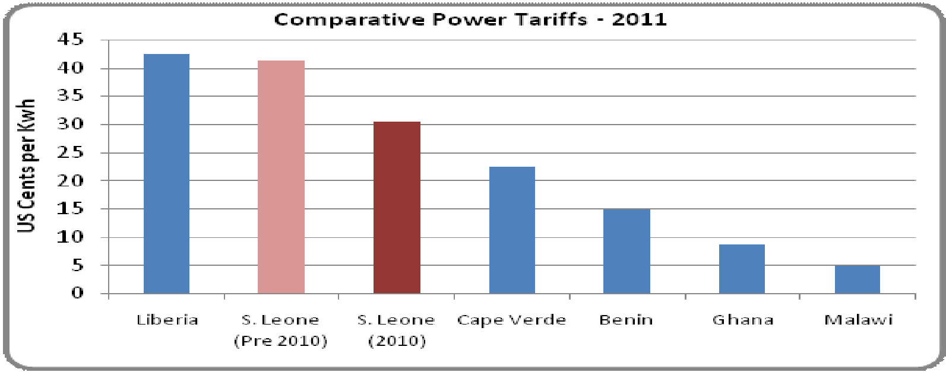
High Power Tariffs and Unmet Demand
Has one of the highest power tariffs in the sub – region
High demand (236MW) and low supply (78.5MW), hence High Unmet Demand – 157.5MW

Slide 18
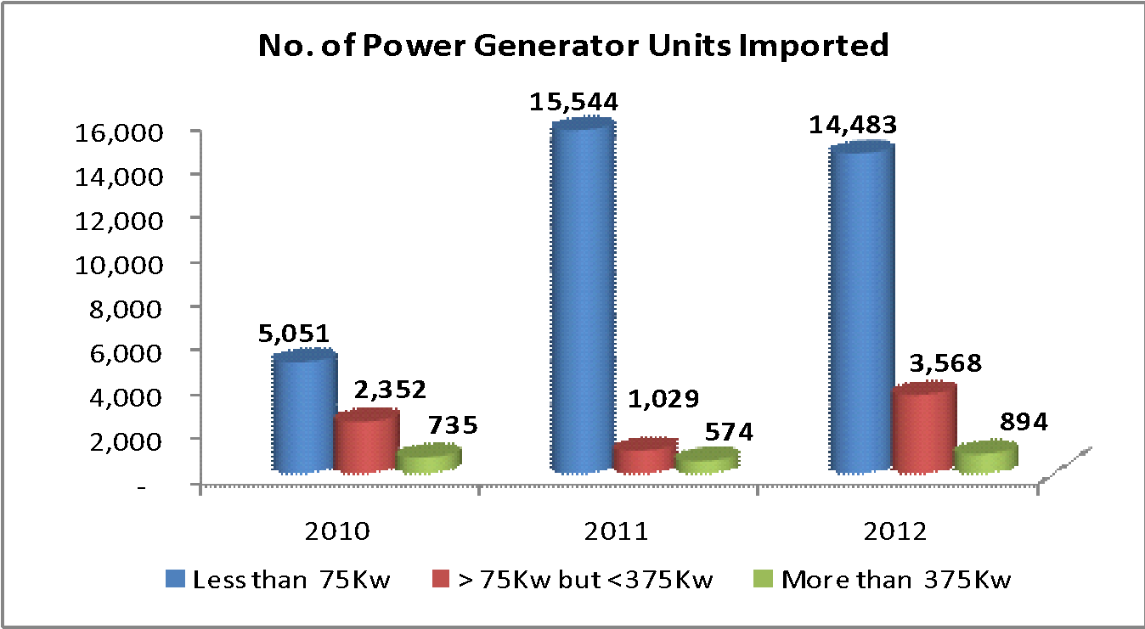
Households demand for Generator has Increased
………..this signals high level of circumvention by households

Slide 19
Percent of firms owning or sharing a generator has increased
……….this also shows a lot of firms are trying to bypass the constraint
Percent of Firms Owning or Sharing a Generator
Country | Country Average | Small Firms | Medium Firms | Large Firms | Year
The Gambia | 20.7 | 15.2 | 25.7 | n.a. | 2006
Guinea | 59.9 | 60.6 | 47.3 | 82.9 | 2006
Sierra Leone | 81.8 | 80.7 | 86.4 | 100 | 2009
Malawi | 25.3 | 4.1 | 34.4 | 46.0 | 2009
Liberia | 66.5 | 67.1 | 52.9 | 94.3 | 2009

Slide 20
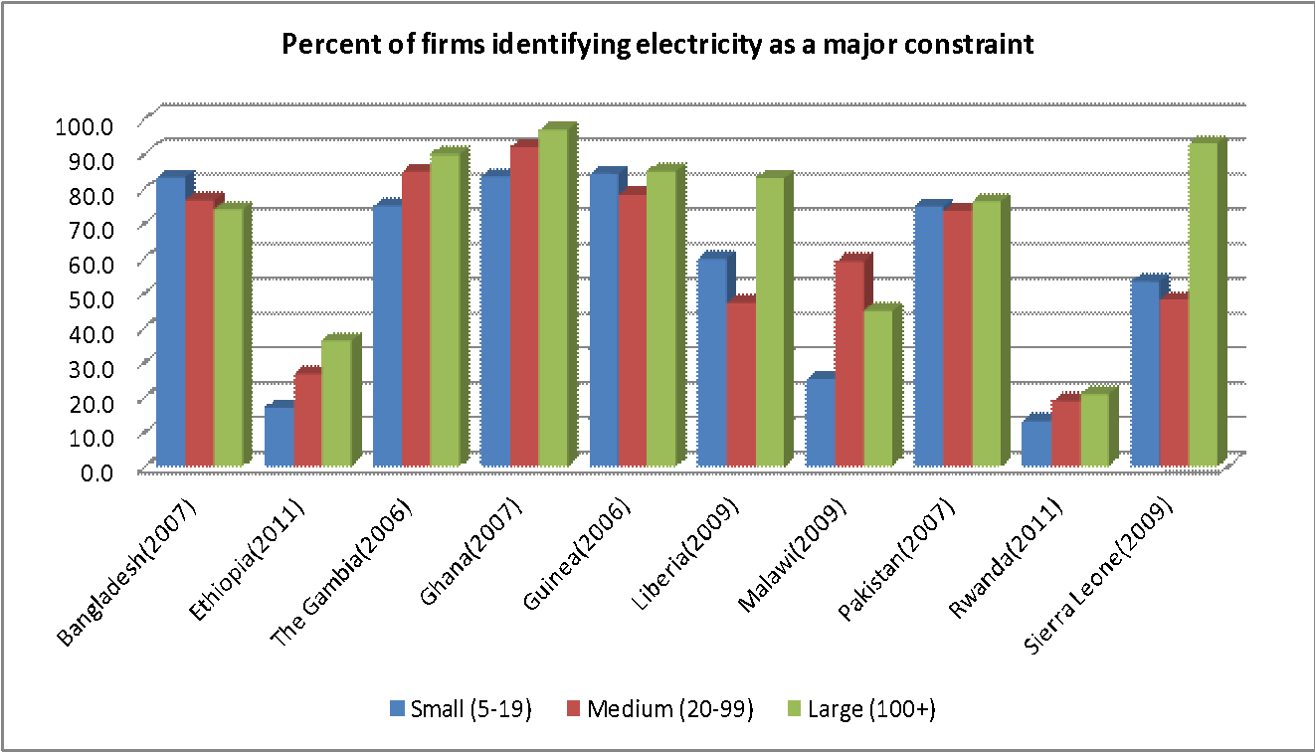
Large number of firms identified electricity as a major constraint to their business

Slide 21
Why is Power therefore a binding constraint to growth
There is High Power Outage (46 days) – about 4 times higher than the average in LICs and costs about 0.7% of GDP in 2009
There is High Unmet demand for Power - High Demand for Power (236 MW) and Low Supply (78.5 MW)
High Level of Circumvention by both Households and Firms through an Increased use of Generator
Large number of businesses identified lack of electricity as a major constraint to their business

Slide 22
Preliminary Findings:
Access to Rural and/or Secondary Roads As A Binding Constraint

Slide 23
The Quality of Sierra Leone’s Road network is among the poorest in Africa
Comparative Analysis of Quality of Roads (2012)
Country | Quality Index | Ranking: Over 144
Sierra Leone | 2.8 | 116
Ethiopia | 4.1 | 64
Gambia | 4.5 | 51
Ghana | 3.5 | 85
Guinea | 2 | 140
Malawi | 3.4 | 89
Rwanda | 5 | 40
Liberia | 3.8 | 76
Pakistan | 3.9 | 73

Slide 24
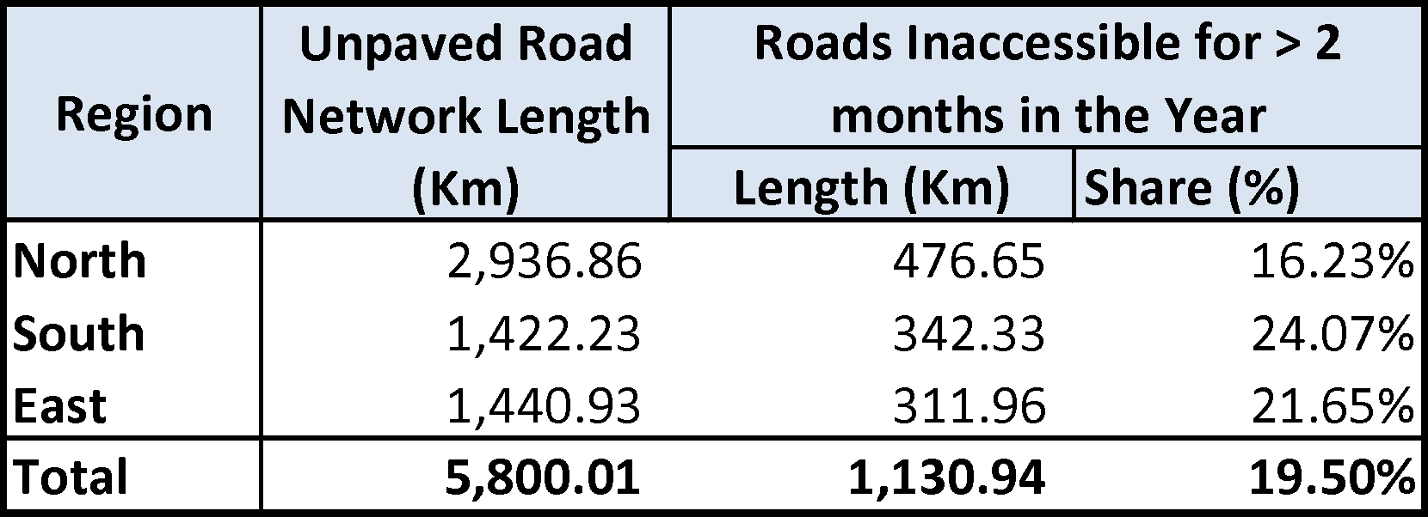
Inaccessibility of Rural Roads
Rural roads are inaccessible for at least two months (approximately 16 percent) of the year during the peak of the rains

Slide 25
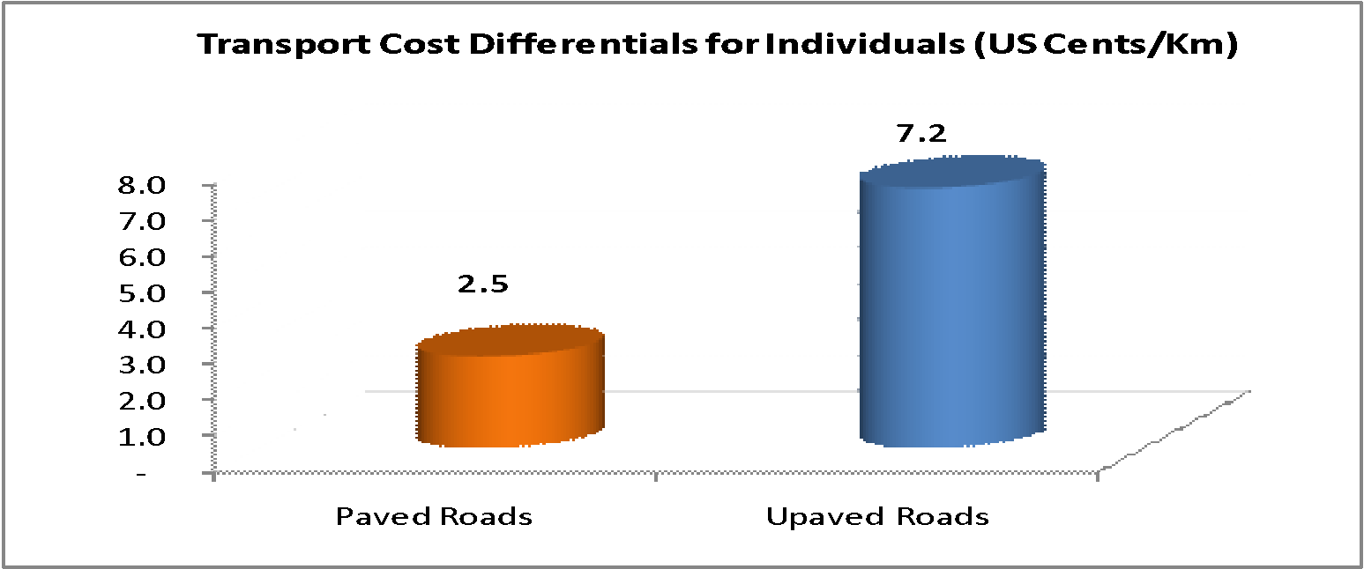
High Transport Costs in Unpaved than Paved Roads
This also imply that transport costs are high in rural areas where there are more unpaved roads than urban areas where there are more of paved roads

Slide 26
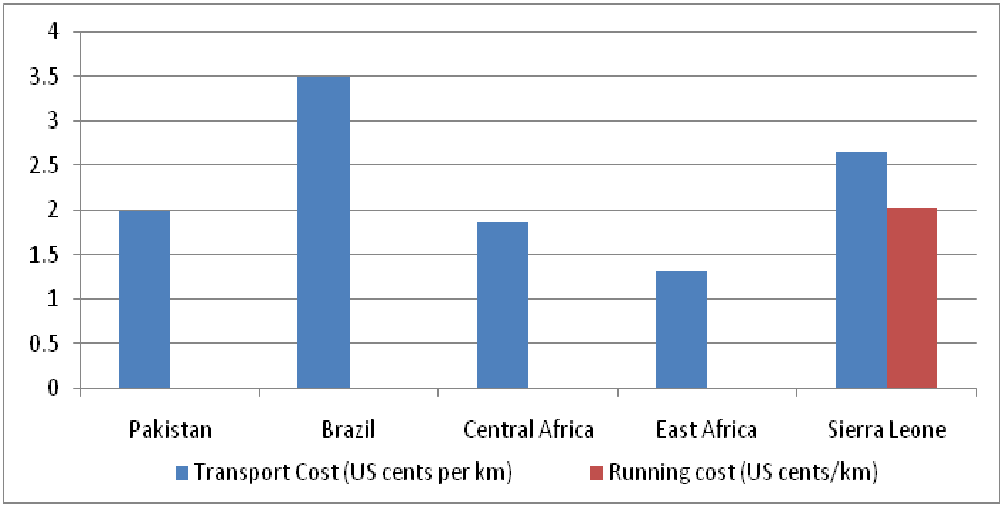
High Transport Cost Globally
Due to bad roads, Sierra Leone has high Transport and Maintenance Costs

Slide 27
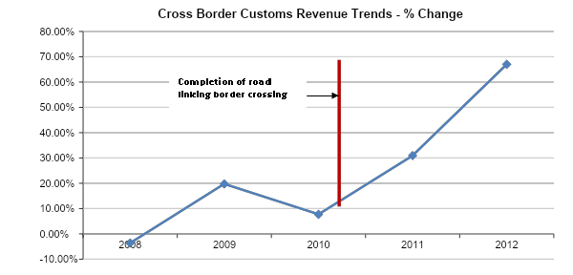
A Good Investment on Road Network would Increase the Volume of Trade
A Road Network facilitates the distribution of agricultural produce; movement of goods and services etc.

Slide 28
A Good Investment on Road Network would Increase the Volume of Trade
Country | Investments (Million US $) |  | Change (%) | Network Upgraded (Km) | Change in Trade (%)
 | Current | Upgraded
Guinea | 727 | 165.1 | 924 | 2,733 | 127
Mali | 149.9 | 246.2 | 96.3 | 2,077 | 64
Ethiopia | 67.5 | 115.2 | 47.7 | 4,239 | 71
Sierra Leone | 19.5 | 33.5 | 14.0 | 609 | 72
Senegal | 307.1 | 473.2 | 166.1 | 1964 | 54
Equatorial Guinea | 35.6 | 526 | 17.0 | 109 | 48
South Africa | 2500 | 60228 | 35228 | 8655 | 141

Slide 29
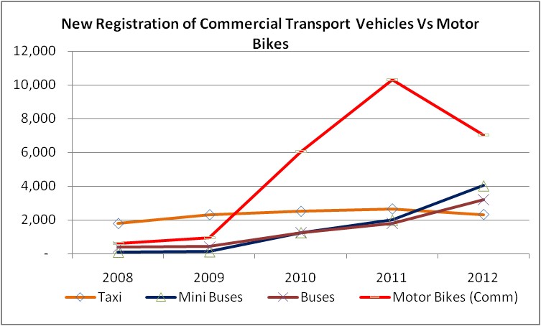
Increased Use of Okada’s
Due to the inaccessibility of majority of the road network, the demand for “Okada’s” has increased over the years

Slide 30
Why is Road therefore a Binding Constraint
Very Poor Road Network Quality – Among the worst in Sub Saharan Africa
High Levels of Inaccessibility especially Rural Roads
High Transportation and Maintenance Costs
An Increased Investment on Road Network will Improve Trade and hence Growth
High Level of Circumvention indicated by the increased demand for OKADA’s

Slide 31
Access to Water and Sanitation As A
Binding Constraint

Slide 32
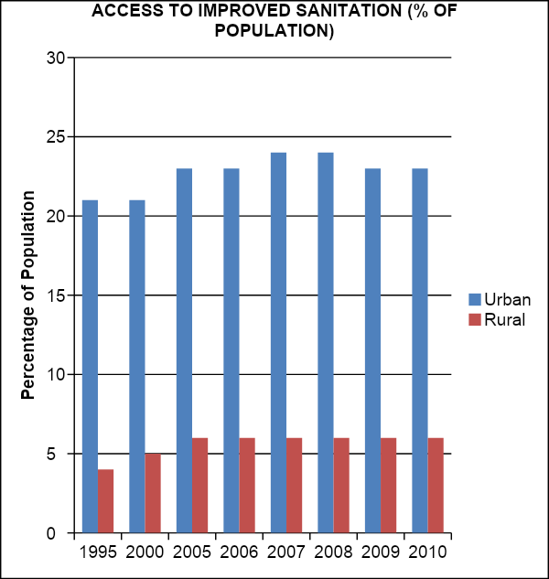
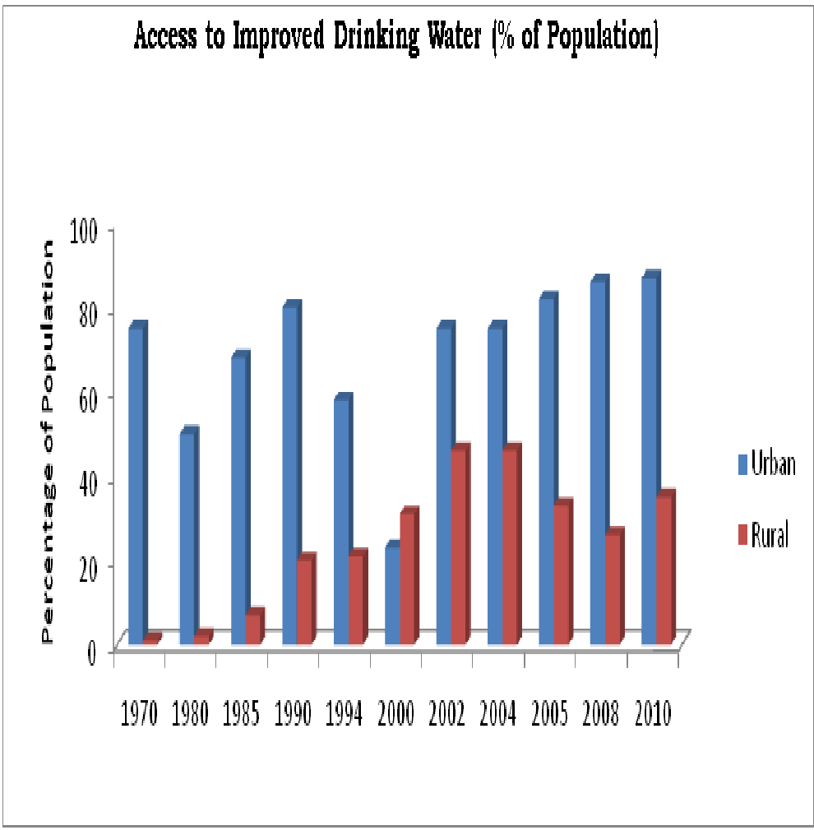
Low supply of water and sanitation
…especially in rural areas

Slide 33
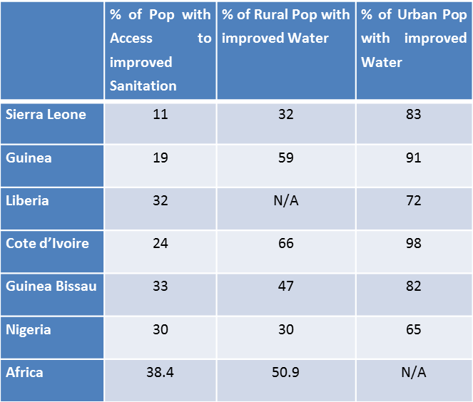
Low supply of water and sanitation
…and in comparison to neighboring countries and the region

Slide 34
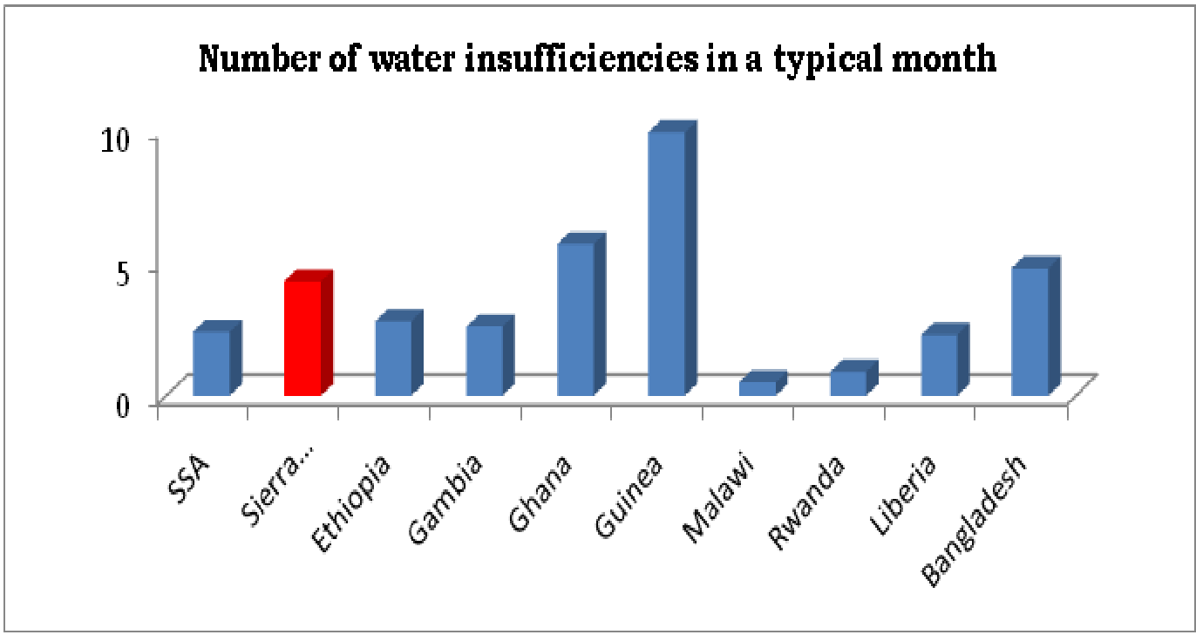
There is high demand for water, even unmet demand
Due to wastages, distributional and institutional (GUMA & SALWACO) problems

Slide 35
Costs of low water and sanitation supply?; Why is this a constraint to growth?
High demand and low supply
  Firms/households pay a high price for water; water is expensive
Removing the constraint would lead to increased growth or productivity
  High health care expenses from water borne disease and lost productivity caring for self or others
  Lost time collecting water; impacts wages and firm productivity
People are trying to get around the constraint
  Using unsafe water sources, especially in rural areas

Slide 36
Low supply of water and sanitation as a binding constraint
Summary: Households spending time and money because of low supply of water and sanitation
  Constraints Analysis estimate of total economic cost = approximately USD $93 per year per household
  This includes: Cost of water + Health expenses + Value of time lost to illness and water collection
Possible Impact on Women and Youth:
  Women and Youth spend a lot of their productive time to collect and use water for cooking and other household work
  Women are also mostly responsible for care of the sick in the family
  Added burden on women which can impact their health, time to engage on productive activities and limiting their contribution to economic growth.

Slide 37
Preliminary Findings:
Policy and Institutional Effectiveness As A Binding Constraint

Slide 38
Large Informal Sector
According to 2006 IFC/World Bank survey of informal sector in Sierra:
  86% say the high cost and burden of licenses
  75% say the tax burden
  36% of completely informal businesses know nothing about the procedures for formalization in their area of business, and another 40% only know a few detail
Failure to formalize:
  27% found it too costly
  26% found the steps too complicated
  22% were unable to find the necessary information

Slide 39
Taxes
Doing Business estimates
  33 payments per year
  357 hours per year
  Driven largely by Social Security (12 payments, 168 hours, 10% rate) and GST (12 payments, 174 hours, 15% rate)
Businesses can save up to 25% and about 40 days per year on taxes alone by remaining informal

Slide 40
Effects of tax inefficiencies
Policy ineffectiveness leads to institutional ineffectiveness
  More informal firms require more revenue agents to try to collect taxes
  Low tax revenue as a percentage of GDP is shown in CA
  Lower tax revenue leads to more borrowing or reduced spending on needs such as infrastructure (also shown in CA)

Slide 41
Not just Taxes but a Restrictive Land Tenure System
Majority of the 40% of agricultural land for production is found outside the capital
The land tenure system in Sierra Leone has to a large extent restricted investments
The restriction to land ownership both by foreign nationals and “non indigenes” constraints investments especially because majority of large investments are mostly foreign owned. Traditionally, women do not own land and landed property restricting access and security of tenure leaving them vulnerable to poverty.

Slide 42
Sierra Leone Ranks Low in her ability to lease land to foreigners and “non indigenes”
Indicators | Country Score | IAB Regional Average | IAB Global Average
Strength of lease rights index (0-100) | 44.4 | 76.6 | 82.1
Access to land information index (0-100) | 26.3 | 33.9 | 41.4
Availability of land information index (0-100) | 30 | 58.5 | 70.6
Time to lease private land (in days) | 210 | 72 | 61
Time to lease public land (in days) | 277 | 151 | 140

Slide 43
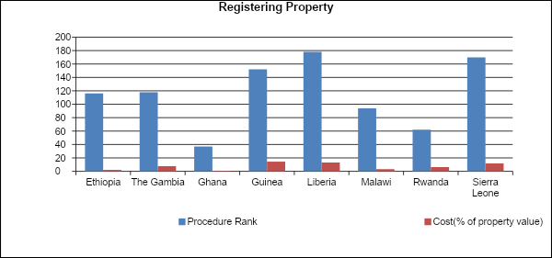
The Process of Registering Property is tedious
Since the Process is Cumbersome, the Associated Costs are HIGH

Slide 44
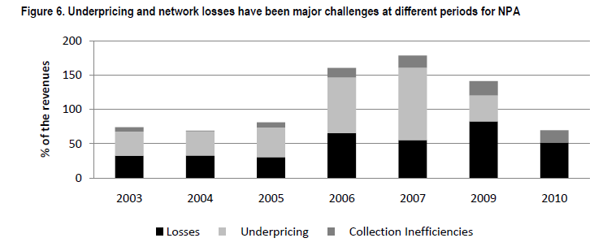
Not just Taxes and Land, but also Government Parastatals
  NPA, SLRA and GVWC cannot maintain infrastructure because of institutional inefficiencies (institutional ineffectiveness)
Source: Pushak and Foster, 2011

Slide 45
Why is Institutional and Policy Effectiveness a possible binding Constraint
Large informal sector – Pays too many taxes (33 payments in a year) hence evades tax and payment of Social Security
The Land Tenure System has deterred Investments (both domestically and internationally with women having least access)
It takes on average about 240 days (8 months) to lease a land
Sierra Leone is among the worst performers in registering a property
NPA, SLRA, GVWC,SIERRATEL etc cannot maintain infrastructure because of institutional inefficiencies – Underpricing, collection inefficiencies and losses.

Slide 46
Conclusion
From the available data and analysis made, the following conclusions can be made:
As a post conflict country, Sierra Leone’s growth has averaged 5% per year
Private investments, which should propel growth, have been considerably low due to a number of factors
Identified four likely binding constraints to private investments – Power, Rural roads, Water and Sanitation, and Policy and Institutional Effectiveness.

Slide 47
THANKS…………
QUESTIONS AND CONTRIBUTIONS

