Slide 1
INTER-PARLIAMENTRY UNION WORKSHOP IN SIERRA LEONE
MARCH 26 AND 28 2014 HELD IN THE PARLIAMENT OF THE REPUBLIC OF SIERRA LEONE

Slide 2
SHORT PRESENTATION ON VIOLENCE AGAINST WOMEN AND GIRLS
SOME OF THE ROOT CAUSES of VAWG
By
Thomas R.A.Winnebah, Njala University

Slide 3
OUTLINE OF THE PRESENTATION
Background
  Key concept in GAD
  Definition of VAWG
  When and Forms/types of VAWG
  Places of manifestation
  Who is affected by VAWG
  Why VAWG is an issue
Some of the Root Causes of VAWG
Conclusions

Slide 4
Background – Key GAD Concepts
Sex is the biological and physiological characteristics of males and females (including the recently growing neuter gender).
Gender is defined as the socially constructed roles and relations of males and females relative to the level of development.
Imbalances in the construct constitutes the gender issue that GAD seeks to correct by enhancing equality in roles, equity in resources and empowerment in decision making for the disadvantaged gender.

Slide 5
Background – Definition of VAWG
United Nations declaration on Violence Against Women "Gender-based violence is violence involving men and women, in which the female is usually the victim; and which is derived from unequal power relationships between men and women. Violence is directed specifically against a woman because she is a woman, or affects women disproportionately. It includes, but is not limited to, physical, sexual and psychological harm (including intimidation, suffering, coercion, and/or deprivation of liberty within the family, or within the general community). It includes that violence which is perpetrated or condoned by the state". - (UNFPA Gender Theme Group, 1998)’.

Slide 6
Background – Forms of VAWG and When
PHASE OF LIFE | PREDOMINANT TYPE OF VIOLENCE
Prenatal | Prenatal sex selection, battering during pregnancy, coerced pregnancy
Infancy | Female infanticide, neglect, emotional and physical abuse, differential access to food and medical care
Childhood | Genital mutilation/cutting; incest and sexual abuse; differential access to food, medical care, and education; children who are engaged in sex work, differential access to food and medical care, early and forced marriage
Adolescence | Dating and courtship violence, sexual abuse in the workplace, economically coerced sex, rape, sexual harassment, forced sex work, differential access to food and medical care
Reproductive/ Adulthood | Abuse of women by intimate partners, marital rape, dowry abuse and murders, partner homicide, psychological abuse, sexual abuse in the workplace, sexual harassment, rape, abuse of women with disabilities, differential access to food and medical care, coerced pregnancy, forced sterilization
Old Age | Abuse of widows, elder abuse (which affects mostly women), differential access to food and medical care

Slide 7
Background – Who is affected
Anybody can be sexually assaulted regardless of age or circumstance. Women are the main victims (http://homepages.iol.ie/~duacon/violence.htm accessed on 24/3/14).
However, violence against males is not on the same scale, severity, type or nature, persistence and deliberate compared to females (http://www.gadnetwork.org.uk/the-violence-against-women/; (http://homepages.iol.ie/~duacon/violence.htm accessed on 24/3/14).
Women living in precarious condition or discriminated against on the basis of race, language, ethnic group, culture, age, opinion, religion or membership in a minority group

Slide 8
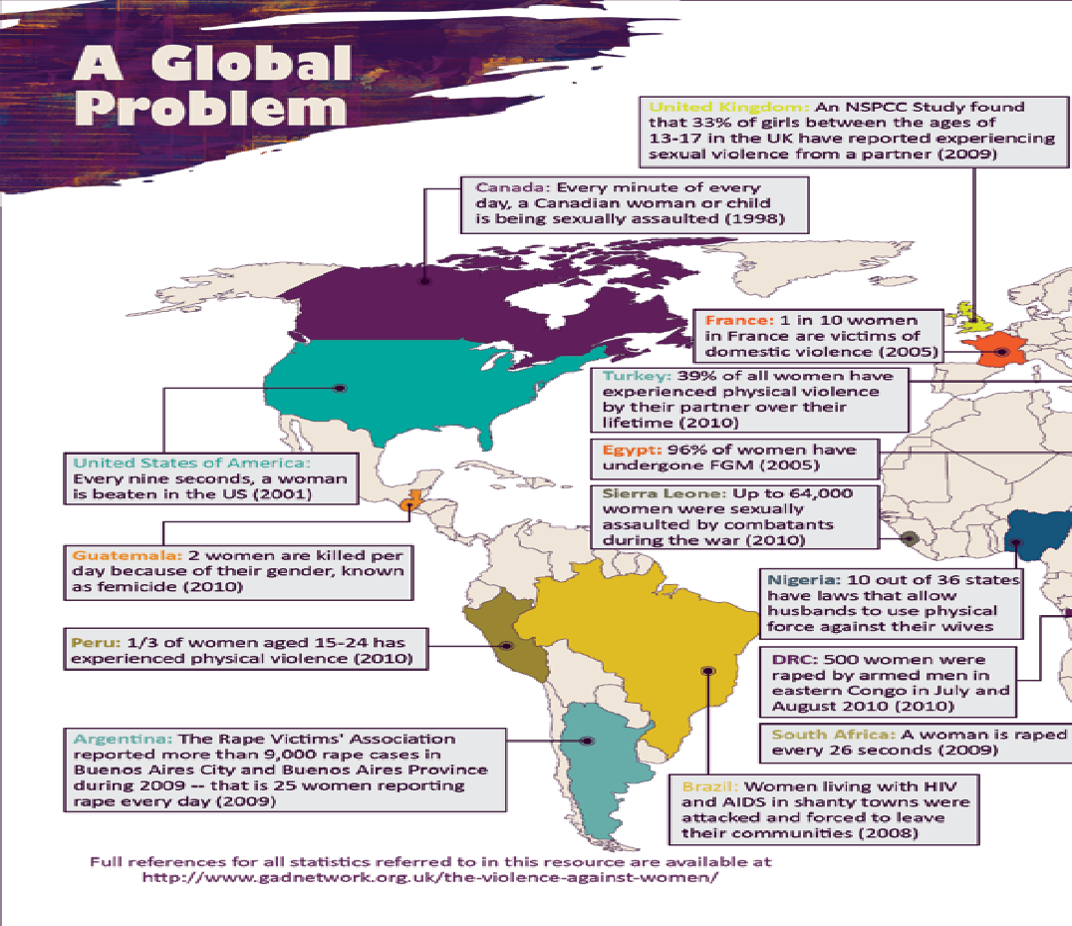
Background – Where: Western Hemisphere of the globe

Slide 9
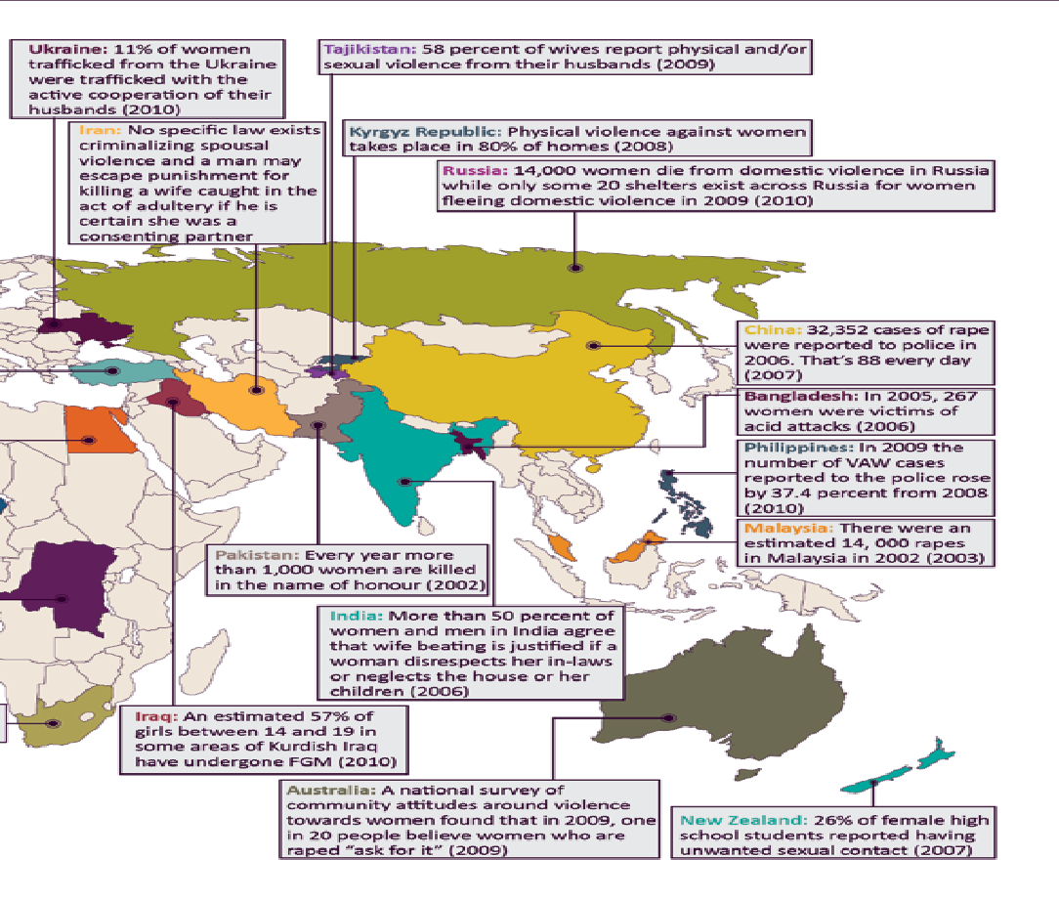
Background – Where affected: Eastern Hemisphere of the Globe

Slide 10
Background – Why VAWG is an issue?
The forms of violence are grave social problem and threatens the safety, equality and bodily integrity of every woman in the past. It is now considered a criminal acts and has attracted more international attention (http://worldsavvymonitor.wordpress.com/2009/10/23/violence-against-women-in-times-of-war-a-look-at-root-causes/ accessed on 24/3/14; http://homepages.iol.ie/~duacon/violence.htm accessed on 24/3/14) although the root causes and hence its persistence are less understood in the first place. Hence this presentation to stimulate discussions.

Slide 11
Some of the Root Causes of VAWG: Patriarchy
The patriarchal system has exerted control by males over females lives historically (http://unilorin.edu.ng/publications/jekayinoluwa/22.%20and20Causes%20Original.htm accessed 24/3/14). Patriarchal terrorism, where one partner uses economic and social power to maintain control over another human is very common in India and other Asian countries due to the subservient status of women. In India, men are still considered to be the bread-winner (Raman, 2011). Ideologies of male sexual entitlement persist in both rural and urban location among (non) formally educated people. Sierra Leone is still a patriarchal society (http://www.who.int/mediacentre/factsheets/fs239/en/ accessed on 24/3/14).

Slide 12
Some of the Root Causes of VAWG: Early Marriage
Early marriage is the root cause of many forms of suffering and discrimination against women in Bangladesh (,http://archive.thedailystar.net/newDesign/news-details.php?nid=157317 accessed 24/3/14). It used to be practiced in Sierra Leone among many ethnic groups, particularly the Fulas, Madingoes but is now on the decline due to the during and post conflict pro-girl child education policies, programmes and projects

Slide 13
Some of the Root Causes of VAWG: Marital roles and relations
Dissatisfaction with the initial dowry resulting in continued exploitation of women for not cooking properly or on time, going out of home without telling her husband or in-laws and suspicion of extra marital affairs (Source http://lalitaraman.com/2011/10/05/violence-against-women-%e2%80%93-what-is-the-root-cause/ accessed 24/3/14; http://www.who.int/mediacentre/factsheets/fs239/en/ accessed on 24/3/14).

Slide 14
Some of the Root Causes of VAWG: Reproductive expectations
Infertility or giving birth to girls rather than boys in India and otherwise for some Sierra Leonean men to keep the lineage (Source http://lalitaraman.com/2011/10/05/violence-against-women-%e2%80%93-what-is-the-root-cause/ accessed 24/3/14). Non acceptance of Girl right from the time the parents know that the foetus is a girl thereby leading to Killing the female foetus and female infanticide in India (Raman, 2011).

Slide 15
Some of the Root Causes of VAWG: Economic power differences
In the past, many women and children feared losing economic dependence on men by breaking the cycle of dependence to seek help (http://homepages.iol.ie/~duacon/violence.htm accessed on 24/3/14).
In today’s world, some women earn more than her husband either in the workplace or in informal sector activities in Sierra Leone since the late 1980’s. This tends to erode the once financial dependence of women on husbands and makes men feel threatened (Source http://lalitaraman.com/2011/10/05/violence-against-women-%e2%80%93-what-is-the-root-cause/ accessed 24/3/14; http://worldsavvymonitor.wordpress.com/2009/10/23/violence-against-women-in-times-of-war-a-look-at-root-causes/ accessed on 24/3/14; http://unilorin.edu.ng/publications/jekayinoluwa/22.%20and20Causes%20Original.htm accessed 24/3/14; http://homepages.iol.ie/~duacon/violence.htm accessed on 24/3/14).
In Sierra Leone, some men became disadvantaged and assumed the stereotype roles of their spouses, particularly in urban settings.

Slide 16
Some of the Root Causes of VAWG: Cultural Beliefs and myths
In India, the girl child is seen as a financial burden because the parents are obliged to give dowry on demand from the spouse (Raman, 2011). Hence, the boy child is highly favoured as a source of wealth and financial gain to his family. This translates into superiority complex to most typical males.
Women stay in an abusive relationship (even the most educated and literate) because the fear of leaving is greater than the fear of staying in the marital relationship.

Slide 17
Some of the Root Causes of VAWG: Cultural Beliefs and myths
In addition, the fear of not been accepted by her parents, community members and the wider society lures her to risk her own life under persistent violence by her spouse (Raman, 2011). This expectation is commonly expressed during traditional marriage rites among many ethnic groups in Sierra Leone.
Next, women tend to endure violence in conjugal relationships to prevent the children from undergoing hardships if she separates from the spouse (Raman, 2011). This is strongly expressed by rural rather than urban women in rural Sierra Leone. Also the traditional and orthodox mindset makes them bear the sufferings without any protest.

Slide 18
Some of the Root Causes of VAWG: Cultural Beliefs and myths
Mythological, the violation of socially constructed dress codes for the gender in a community is seen as an act of provocation for the opposite gender to commit sexual violence due to lack of control over desires for sexual gratification on sight and in peculiar spaces including work places and Churches, particularly in Sierra Leone urban and rural settings of late (http://unilorin.edu.ng/publications/jekayinoluwa/22.%20and20Causes%20Original.htm accessed 24/3/14
Challenge is to respect the diverse cultural heritage, while criminally exposing practices that violate universal human right standards as reflected in the recent related post-conflict legislations and institutional capacity building (including this workshop) efforts in Sierra Leone (http://www.gadnetwork.org.uk/the-violence-against-women/).

Slide 19
Some of the Root Causes of VAWG: Parental Violence
Witnessing parental domestic violence has emerged as the strongest predictor of perpetration of violence in young people’s own intimate relationships (Raman, 2011; http://www.who.int/mediacentre/factsheets/fs239/en/ accessed on 24/3/14).

Slide 20
Some of the Root Causes of VAWG: Changing lifestyles
In appropriate use of Mobile phones or going to restaurant or drug-abuse tends to trigger violence against the gender, particularly women and girls in contemporary Sierra Leone (http://www.manipurtimes.com/news-article/the-peoples-chronicle-news/item/7412-drug-abuse-the-root-cause-of-crime-against-women-and-children accessed on 24/3/14).

Slide 21
Some of the Root Causes of VAWG: Weak legal systems for sexual violence
There has been long-term existence of unrepealed strict divorce laws making women unable to escape violent situations in some countries (http://www.who.int/mediacentre/factsheets/fs239/en/ accessed on 24/3/14; http://worldsavvymonitor.wordpress.com/2009/10/23/violence-against-women-in-times-of-war-a-look-at-root-causes/ accessed on 24/3/14).
For instance, in the United Kingdom, the law supported the right of men to control their wives by force with guidance on the size and length of instrument used to enforce their dominance and control over their spouse (hence some level of protection from physical abuse) up to the 19th Century (http://homepages.iol.ie/~duacon/violence.htm accessed on 24/3/14) before the act repealed to criminalize the action .

Slide 22
Some of the Root Causes of VAWG: Subordination and discrimination
The subordination of women by men has existed throughout history.
  Through instilling of fear and intimidation, women’s socially constructed gender roles and norms are sustained , on the assumption that women are inferior to men, and that men have the right to control women particularly in social breakdown, when it is often exacerbated and more easily exploited by those in power (http://www.gadnetwork.org.uk/the-violence-against-women/; ActionAid UK et al accessed on 24/3/14; http://homepages.iol.ie/~duacon/violence.htm accessed on 24/3/14).
In most cases, anger and power stimulates sexual violence to dominate and degrade women rather sexual gratification (http://homepages.iol.ie/~duacon/violence.htm accessed on 24/3/14).
As a result unequal power relations persists (http://worldsavvymonitor.wordpress.com/2009/10/23/violence-against-women-in-times-of-war-a-look-at-root-causes/ accessed on 24/3/14).

Slide 23
Some of the Root Causes of VAWG: Religious Values
Interpretations of religious texts are sometimes used to date by the clergy to support violence against women and girls, though both genders have their religious faiths. For example, in Genesis 3, husbands had right to punish their spouse for being sinful behaviors, while in I Peter wives are encouraged to accept such punitive actions from their spouses as a Christ like trait (http://homepages.iol.ie/~duacon/violence.htm accessed on 24/3/14).

Slide 24
Some of the Root Causes of VAWG: Religious Values
Challenge is to respect the values but reject excuses, while criminally exposing practices that violate universal human right standards as on-going in Papal (State) Catholicism though unfortunately for mainly boys (http://www.gadnetwork.org.uk/the-violence-against-women/).

Slide 25
Some of the Root Causes of VAWG: Psychological Warfare
Sexually violating women and girls, particularly rape, during conflict not only hurts them but it is deep humiliation for the men in the target community, while eroding its dignified features and enhancing easy defeat (http://worldsavvymonitor.wordpress.com/2009/10/23/violence-against-women-in-times-of-war-a-look-at-root-causes/ accessed on 24/3/14)

Slide 26
Conclusions
Addressing VAWG is critical and urgent for global sustainable development, particularly in Sierra Leone,
which is more likely to be realised through facilitating debates, (reviewed) legislations, enforcement, planning, implementation, monitoring and evaluation by stakeholders, particularly the primary ones – W&G,
to address myriad of historical, socio-cultural, organisational and structural causes in an interactive environment.

Slide 27
THE END
Thank you for your attention

