Slide 1

MAKING COMPREHENSIVE ABORTION CARE (CAC) SERVICES AVAIABLE/ACCESSIBLE
THE EXPERIENCE OF IPAS ETHIOPIA
October 2013

Slide 2
IPAS ETHIOPIA
  2000: Opened office in Ethiopia and had been supporting PAC
  2005: Abortion law revised;
  Safe Abortion Care permitted for some indications
  2006: Technical and Procedural Guideline for Abortion Care services in Ethiopia launched
        Ipas started to support Comprehensive Abortion Care (CAC) service
  2008: Ipas included Comprehensive Contraceptive (CC) program

Slide 3
GOAL
  Prevent unwanted pregnancy and reduce maternal mortality and disabilities from unsafe abortion
Through provision of
Comprehensive Abortion care (CAC)and contraceptive (CC) services

Slide 4
STRATEGIC OBJECTIVES
Increase access to high quality CAC & CC services
Increase the availability of appropriate RH technologies
Increased community involvement to address women’s sexual and reproductive
Technical support to regional/national efforts to create enabling environment to enhance women’s sexual and reproductive health

Slide 5
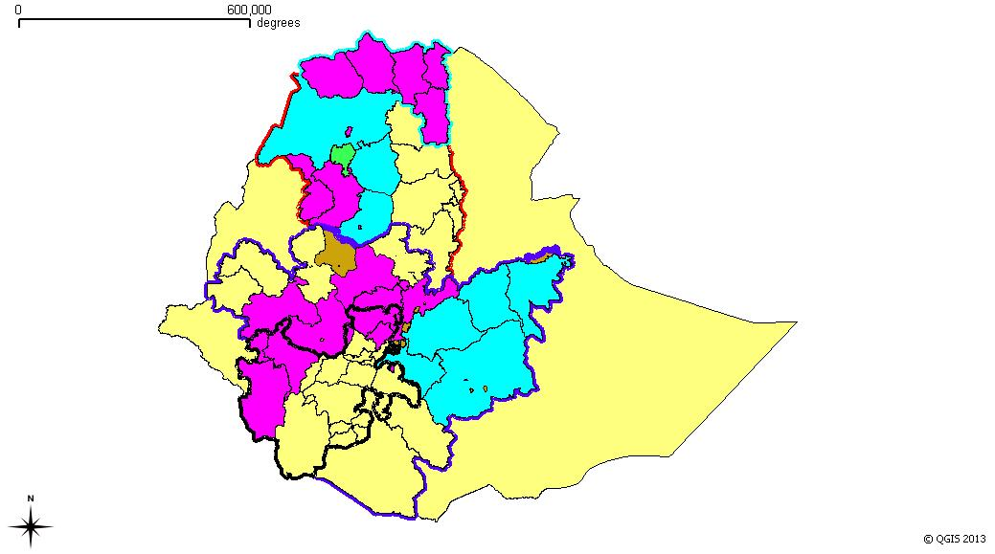
IPAS PROGRAM INTERVENTION AREAS BY ZONE
Anon
PMDUP

Slide 6
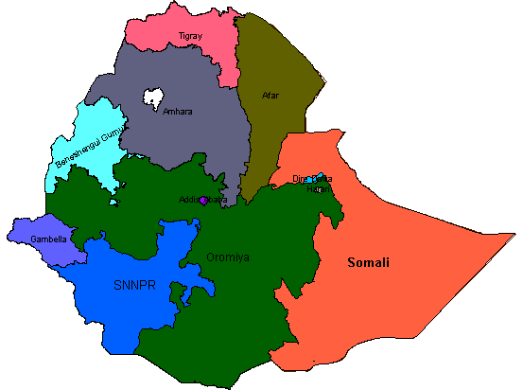
Ipas-ETHIOPIA GEOGRAPHIC COVERAGE
Tigray
80 HF
  Intervention sites
  4 major regions + AA
  support 576 HF
    428 Anon,
    148 PMDUP
  528 public + 48 pvt.
Amhara
135 (60 PMDUP)
Addis
48 HF
Oromia
211 (88 PMDUP)
SNNPR
100 HF

Slide 7
PROGRAM COMPONENTS
Training and post training support
Equipment & Supplies
Community Mobilization and health education
Research and Evaluation

Slide 8
TRAINING
Training of health workers
  Training on CAC
                Post training provider support
  Training on CC
  Orientation of program coordinators
  Orientation of pharmacy personnel
  Refresher training
Supporting pre-service institutions

Slide 9
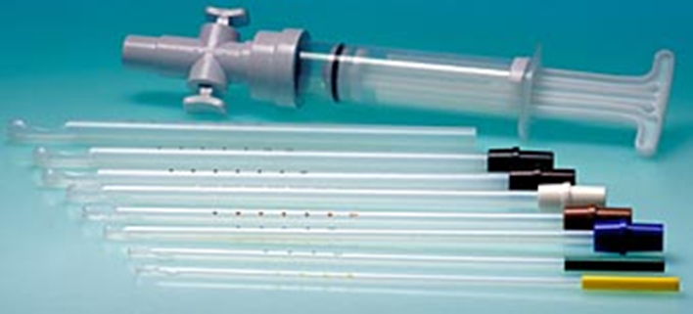
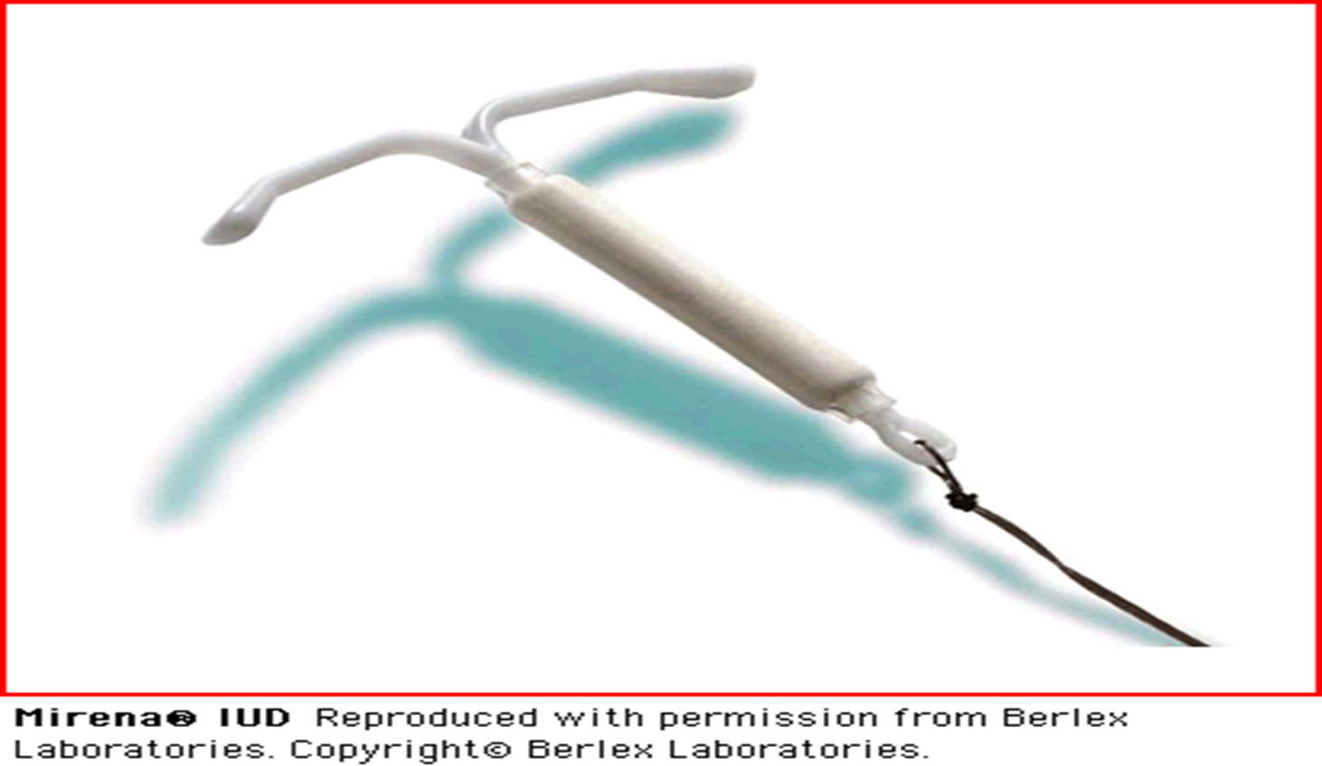
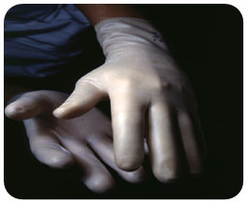
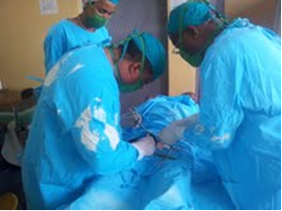
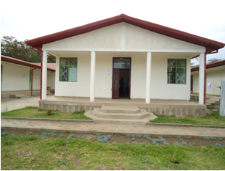
COMMODITIES, EQUIPMENT SUPPLY AND REFURBISHMENT OF SERVICE PROVISION ROOMS
CAC commodities: MVA set, MA
FP commodities: LAFP commodities: Implant and IUCD; LAFP insertion and removal kits
IP material package: PPEs, disinfectants…
Permanent FP method kits: mini laparotomy, vasectomy kits
Refurbishments of CAC/CC rooms: furniture supply

Slide 10
OTHER SYSTEM STRENGTHENING ACTIVITIES
Supportive supervision
Review meetings
Technical support to the health system (FMOH, RHBs, ZHDs)

Slide 11
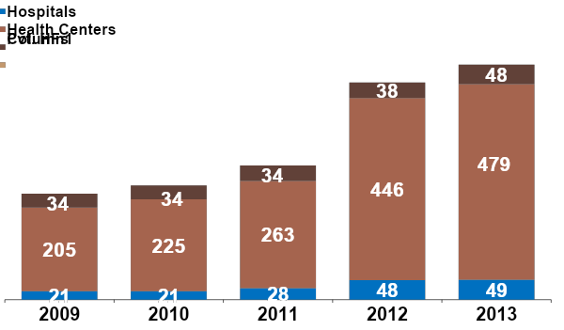
TREND ON NUMBER AND TYPE OF INTERVENTION HFS
(2009 - 2013)
532
576
280
325
260

Slide 12
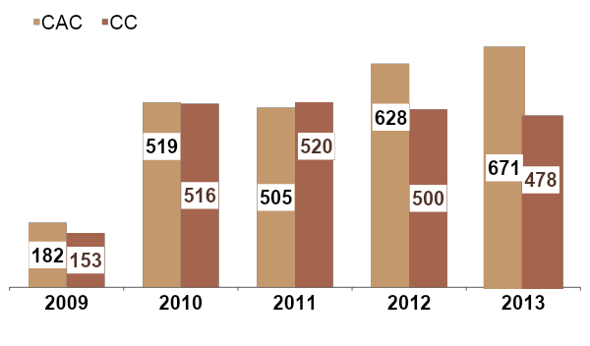
NUMBER OF TRAINED PROVIDERS,
(2009 - 2013)

Slide 13
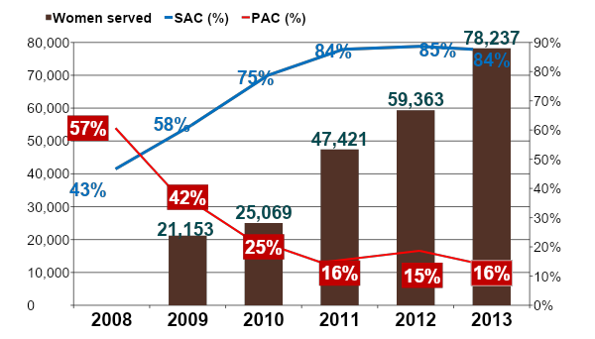
TREND OF WOMEN SERVED FOR CAC AND PROPORTION OF SAC VS PAC (2009 - 2013)

Slide 14
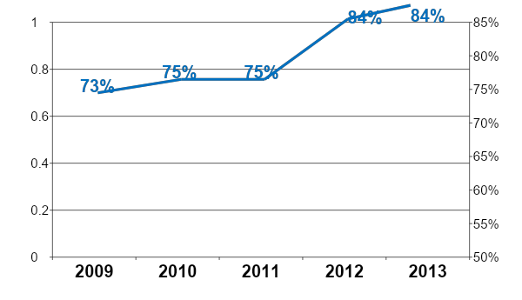
TREND ON POST ABORTION FAMILY PLANNING (PAFP) ACCEPTANCE
(2009 - 2013)

Slide 15
CHALLENGES
  High turn over of trained providers
  Loose ownership of Abortion care program by the health system
  In alignment between the HMIS and our data requirement for successful program improvement

Slide 16
KEY AREAS OF COLLABORATION
  Ensuring that CAC remains an integral part of maternal health care.
  Education initiative to inform women about safe, legal abortion care service
  De-stigmatize abortion:
Even when safe legal options are available, stigma associated with abortion is so powerful that it often leads women to seek an unsafe, clandestine abortion.

Slide 17
THANK YOU

